Slide 1
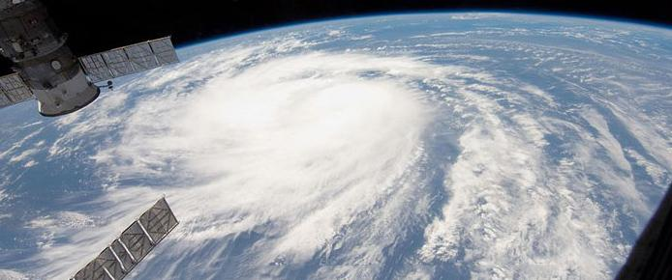
Tropical Cyclone Warning Signals and Meteorological Data in Hong Kong

Slide 2
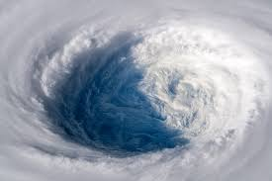
CONTENTS
1
Overview
Association and Frequent Item Analysis
2
3
Correlation and Network
Clustering
4
5
Conclusion

Slide 3
01
Overview
)

Slide 4
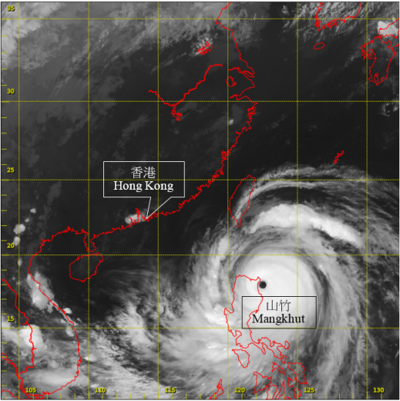
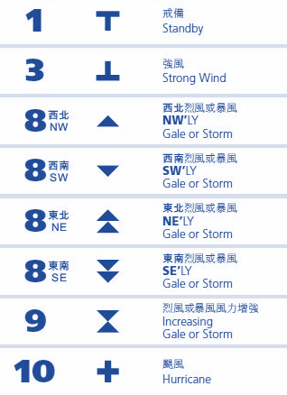
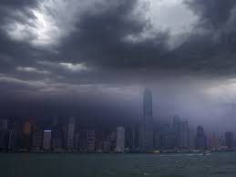
Overview
Introduction of Typhoons in Hong Kong
Typhoon : a mature tropical cyclone which develops from the area between 180° and 100°E in the Northern Hemisphere.
Hong Kong is a coastal city and major port in Southern China, locating in one of the most typhoon-affected area.
The Hong Kong’s tropical cyclone warning signals are a system of signals utilized to notify the influences or threats of typhoons

Slide 5
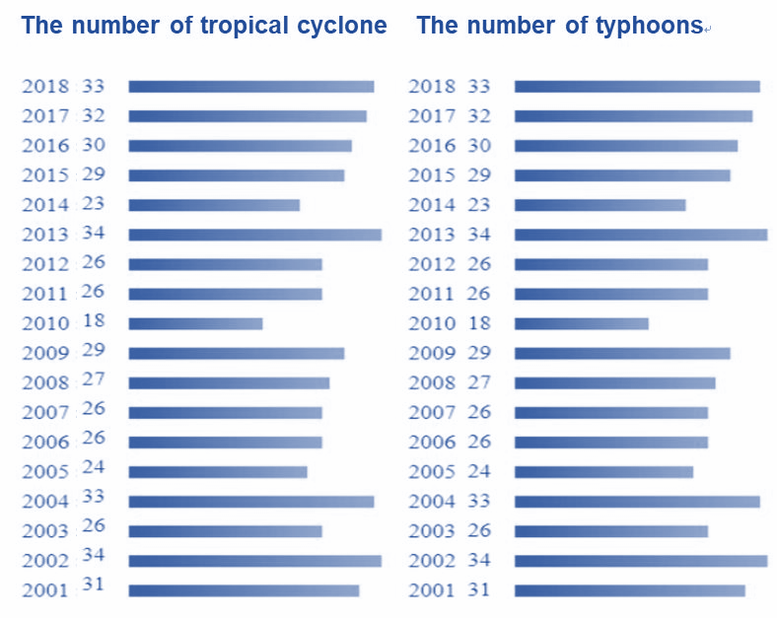
Statistical Data
During 2001 – 2018, total numbers of tropical cyclones and typhoons are respectively 507 and 255, and the average numbers are 29 per year and 13 per year.
The official released Typhoon signals from 2000 to 2018, and the time trend graph shows seasonality.
Graph 2: Official released Typhoon signals during 2000 – 2018 by HK observatory

Slide 6
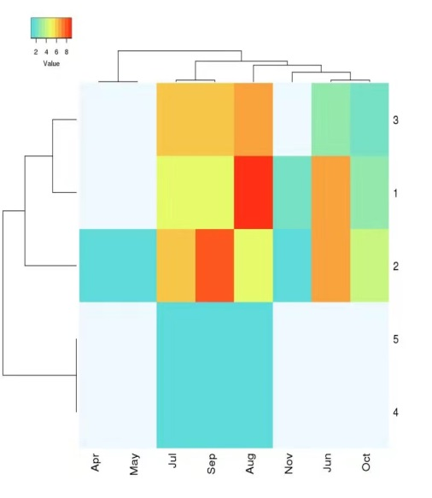

Overview
Heat map and clustering analysis of typhoon seasonality
Signal
8
1
3
10
9
Frequency
1
5
9
13
X-axis only lists the months with typhoons data
Y-axis lists the signal levels
Different colors demonstrate different frequencies of typhoons signals
Lower signals have higher frequency than higher signals
More signals in July to Sep than other months, and higher signals are concentrated during this period
Graph 3: Heat map and clustering analysis of typhoon seasonality and signals frequency.

Slide 7
02
Association and frequent item analysis
)

Slide 8
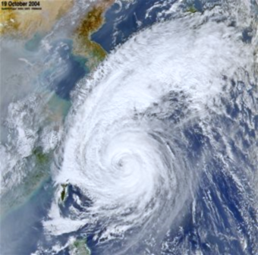
Introduction
Pressure
Temperature
Tropical Cyclone Warning Signals
Dew point
???
Relative humidity
Amount of cloud
Rainfall
To measure the effect on meteorological data, we compare
daily average data with monthly average data.

Slide 9
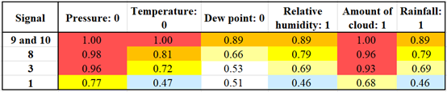
Data processing
If daily average data > monthly average, we mark 1
If daily average data < monthly average, we mark 0
Calculate the confidence of rule:
Signal X Attribute：1 or 0

Slide 10
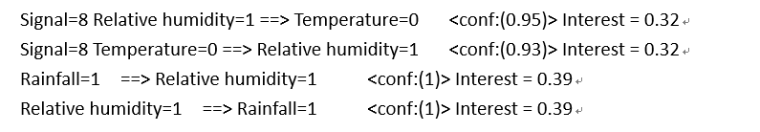
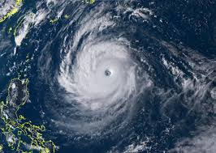
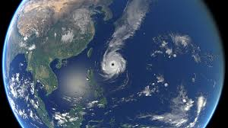
Data processing
Still, using Weka, we get some rules with relatively high interest:

Slide 11

Conclusion
Signal 9 and 10
Pressure
Amount of cloud
Signal 8
Temperature
Tendency to have effect
Signal 3
Rainfall
Relative humidity
Signal 1
Dew point

Slide 12
Correlation and Network Analysis
03
A visualization of relationships between signal, and raised rainfall and temperature
)

Slide 13
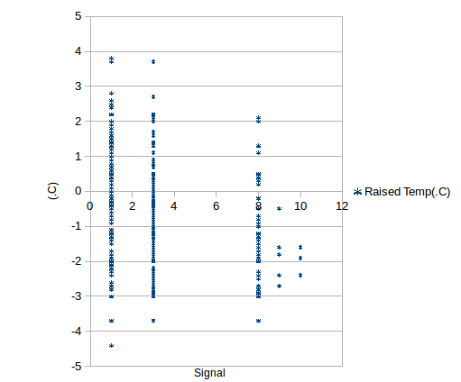
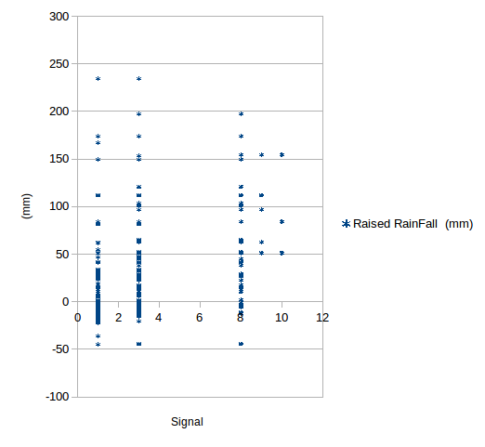
Correlation
Between Signal and Rainfall, Temperature
Pre-process data
Generally, tropical cyclone brings rainfall and lowers temperature

Slide 14

Correlation
between Signal and Rainfall, Temperature
Pre-process data:
Why Kendall’s Tau?
To exclude the comparison between typhoons of same signal level
Rainfall has bigger correlation with Signal
It is proper to classify typhoon into two groups

Slide 15
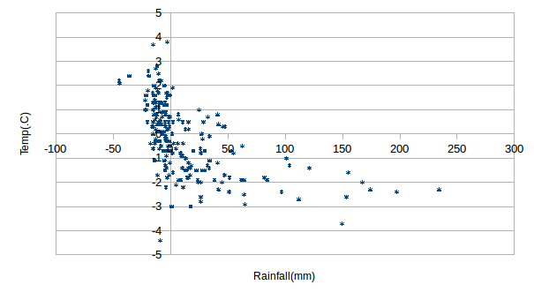
between Raised rainfall and Raised temperature
Two variables are significantly related
→ Reasonable : More rainfall may mean that typhoon carries more cooler air to the land

Slide 16
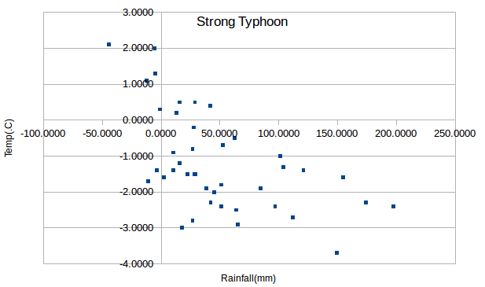
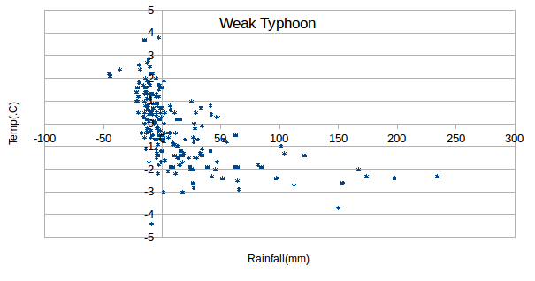
Network
between Rainfall and Temperature
Relatively scattered, discretely distributed
Have obvious cluster

Slide 17
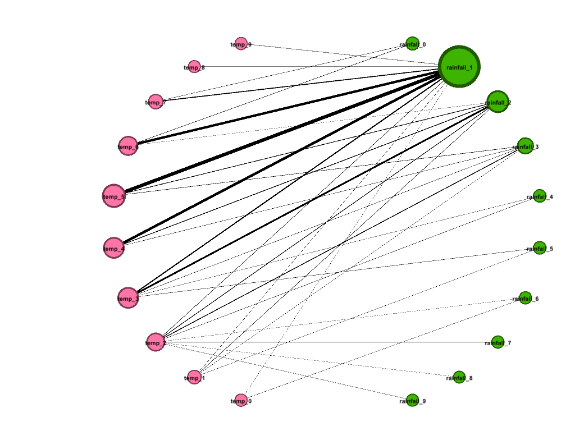
Network
between Rainfall, Temperature
Weak Typhoon
Raised Temp
0
Little
Two variables are divided into intervals ordered top to down
Size of nodes represents “frequency”
Thickness of edges represents the times that weak typhoon (signal {1,3}) happens
Raised Rainfall
0
Conclusion: The combination of little raised rainfall and little raised temperature happens unexpectedly frequently
Lowered Temp
Much

Slide 18
04
Clustering Analysis
)

Slide 19
The mean wind speed (km/h) and the mean amount of cloud (%)
The mean wind speed (km/h) and the mean relative humidity (%)
Get the relationship between
Use “Tanagra”
Do K-means clustering and hierarchical clustering respectively
Get conclusion
Data processing

Slide 20
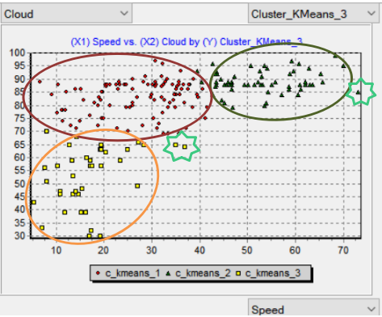
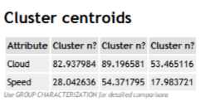
Mean wind speed (km/h) VS Mean amount of cloud (%) Conclusion
The faster the wind speed, the more amount the cloud (proportional relationship)
Abnormalities
Weak comes before strong

Slide 21
Mean wind speed (km/h) VS Mean amount of cloud (%) Conclusion
3 Outliers
Wukong：Signal 3
Greatly influenced Hai Nan province.
Doksuri：Signal 8
Greatly influenced Hong Kong and Guangdong Province.
Vicente：Signal 10
Character: Its signal is high.
Its speed of movement is fast.
To be studied...

Slide 22
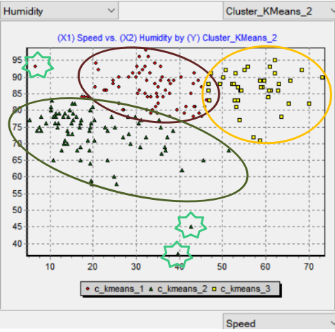
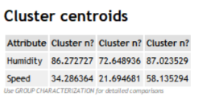
Mean wind speed(km/h) VS Humidity(%)
K-means
A Slightly Positive Correlation
Notes:
The right graph shows the relationship between the mean wind speed and the mean relative humidity. By the K-means method, the cluster centroids can be obtained, which shows there is a slight positive correlation between humidity and wind speed.

Slide 23
Mean wind speed(km/h) VS Humidity(%)
3 Outliers
Doksuri.
Signal in Hong Kong:8
Greatly influence Hong Kong and Guangdong Province.
Wukong
Signal in Hong Kong:3
Greatly influenced Hainan province.
A severe Tropical Storm with no name
signal:3

Slide 24
05
Conclusion and Future work
)

Slide 25
Conclusion and
future work
Meteorological factors
Conclusion: Tropical cyclones are likely to bring lower pressure, lower temperature, more rain and higher humidity, while the directions of No.8 typhoon have little effect on those meteorological data.
Future work: Multivariable regression model, causation analysis, larger dataset………

